Slide 1
Hiring Process Analytics
By Deepak soni

Slide 2
Contents:
Project Description
Approach
Tech-Stack Used
Insights
Result

Slide 3
Project Description:
Analyze the company's hiring process data and draw meaningful insights from it. The hiring process is a crucial function of any company, and understanding trends such as the number of rejections, interviews, job types, and vacancies can provide valuable insights for the hiring department.

Slide 4
Approach:
Understand the data: Before beginning the analysis, I took some time to familiarize with the data. Look at the structure of the data and get a sense of the overall content. This help me identify any potential issues or challenges that I may need to address as I proceed with my analysis.
Check for missing or incomplete data: Make sure to check for any blank values or missing data in your dataset.
Identify and handle outliers: Outliers are data points that are significantly different from the rest of the data. They can have a significant impact on summary statistics and can distort the results of your analysis. It's important to identify any outliers and decide how to handle them, such as by excluding them from the analysis or by treating them as separate cases.
Communicate your findings: Once completed with analysis, present your findings to your audience in a clear and concise way. Use visualizations, such as charts and graphs, to help communicate your results. Be sure to clearly explain your methodology and the implications of your results.

Slide 5
Tech-Stack Used:
Microsoft Excel 2021 — A spreadsheet editor software used mainly by professionals to enter data in table format, perform computations, plot graphs etc. Here Microsoft Excel is used to filter data and plot graphs to get insights about hiring process of the organization.

Slide 6
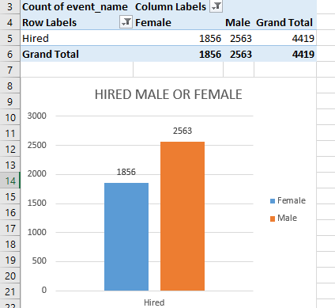
Hiring Analysis:
Q-> Determine the gender distribution of hires. How many males and females have been hired by the company ?
A-> According to the data ,the number of males hired is 2563, while the number of females hired is1856. This means that there are more males who were hired compared to females.

Slide 7
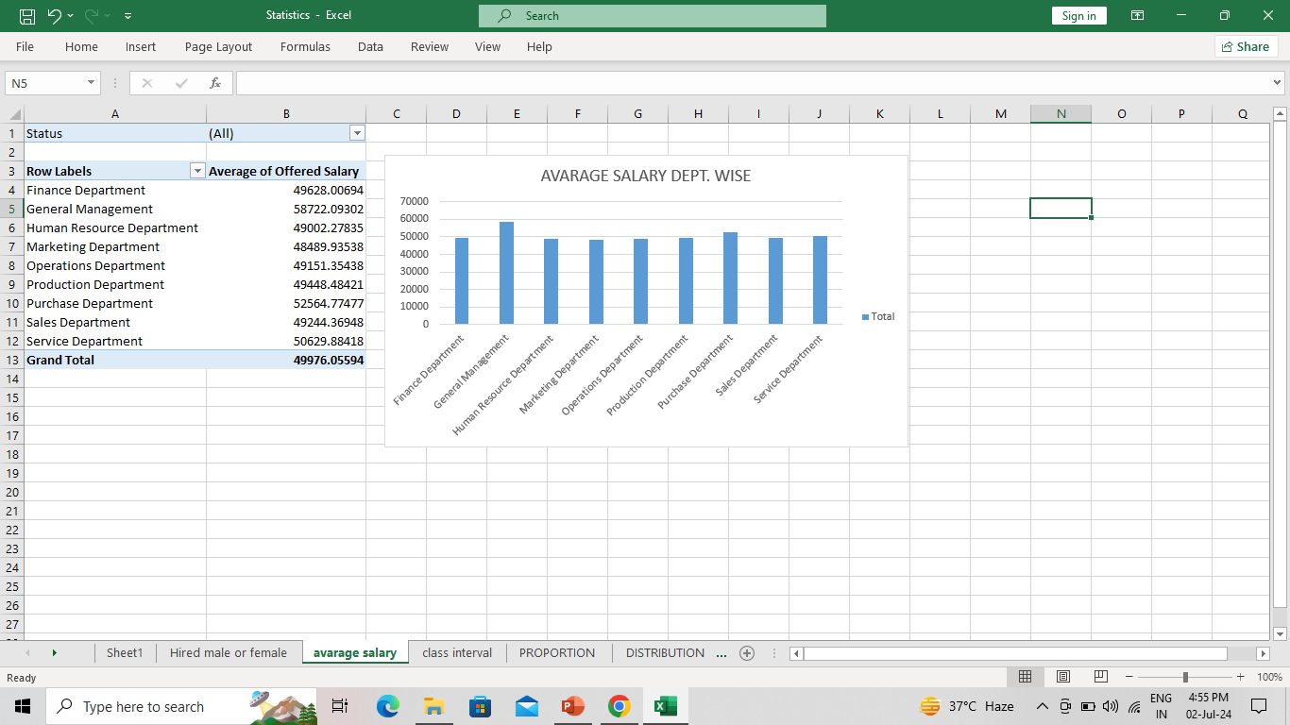
Salary Analysis:
Q-> What is the average salary offered by this company? Use Excel functions to calculate this.
A-> •The data contains outliers, which are data points that are significantly different from the rest of the data.
•Despite the presence of these outliers, they do not affect the average salary.
•If the outliers are included in the calculation, the average salary is 49976.05.
•If the outliers are excluded from the calculation, the average salary is 49878.33 .

Slide 8
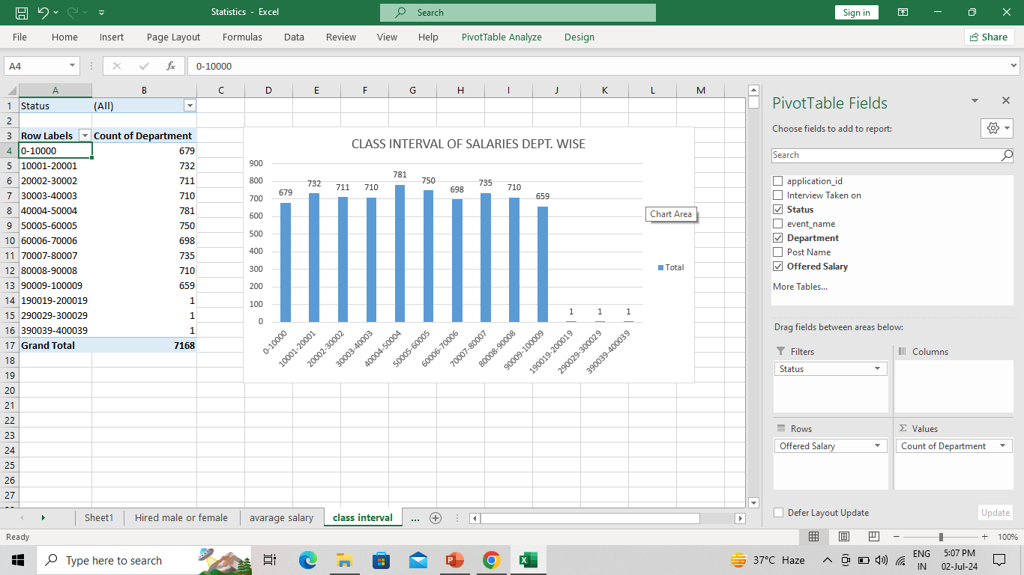
Salary Distribution:
Q-> Create class intervals for the salaries in the company. This will help you understand the salary distribution.
A-> The majority of people in the dataset have salaries within the range of 100,000.

Slide 9
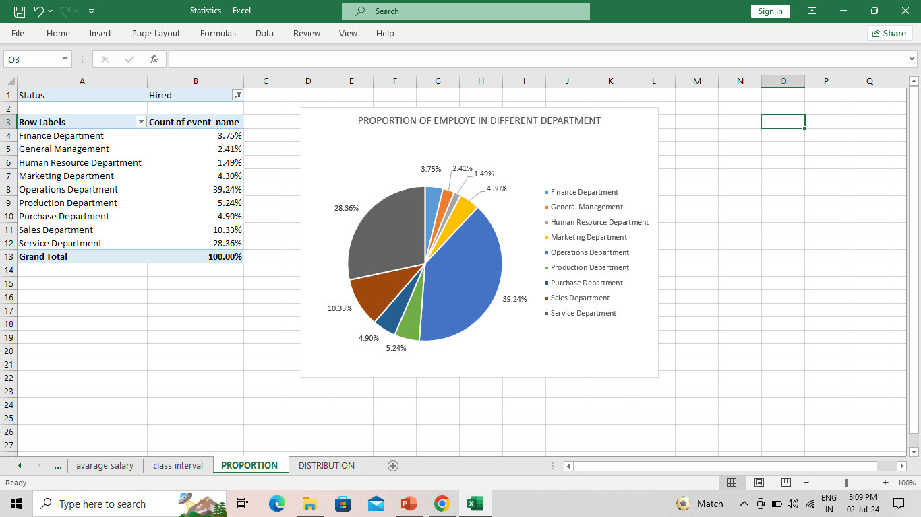
Departmental Analysis:
Q-> Use a pie chart, bar graph, or any other suitable visualization to show the proportion of people working in different departments.
A->A significant portion of the workforce is concentrated in the operations and service departments.

Slide 10
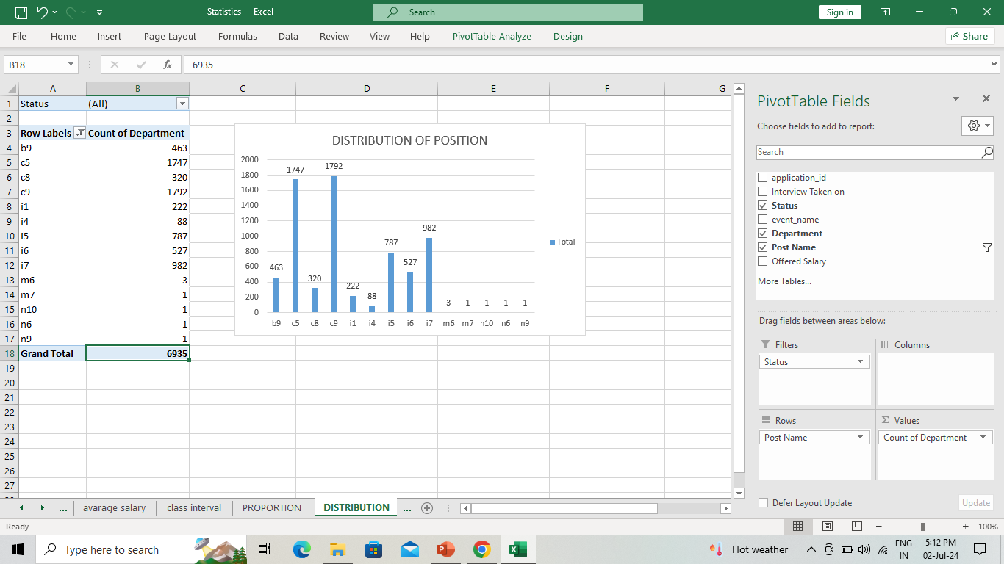
Position Tier Analysis:
Q-> Use a chart or graph to represent the different position tiers within the company. This will help you understand the distribution of positions across different tiers.
A-> The most common job titles among the people in the dataset are C9 and C5.

Slide 11
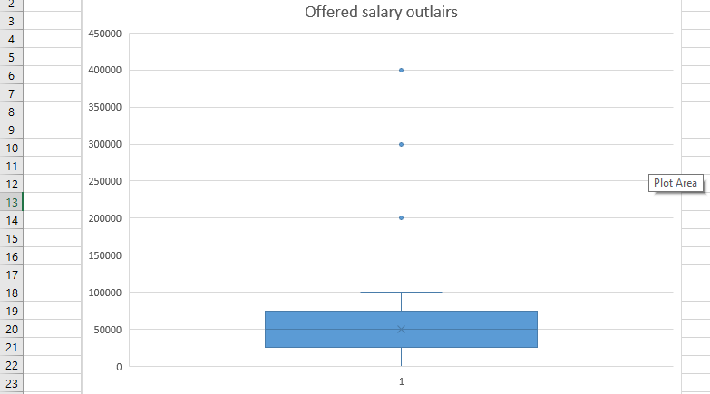
Outlair detection:
The data includes outliers, but they do not significantly impact the average value.

Slide 12
Results:
This project helped me in understanding how important Data Analytics is for Hiring Process of an organization as it provides valuable insights such as number of rejections, reason for rejections, profile of applicants, vacancies etc. which helps the hiring department to take Data-Driven Decisions.

Slide 13
Thank y u

